Slide 1
Customer reviews of several airlines' services and their predicted responses.

Slide 2
BUSINESS UNDERSTANDING
Building and Evaluating a Machine Learning Model Using Airline Reviews Data
Problem Description: The task is to develop a machine learning model that predicts whether a customer is likely to recommend an airline based on their reviews. This is a supervised learning problem, specifically a binary classification task, with the following output classes:
1: Yes (Customer is likely to recommend)
0: No (Customer is not likely to recommend)

Slide 3
DATA UNDERSTANDING

Slide 4
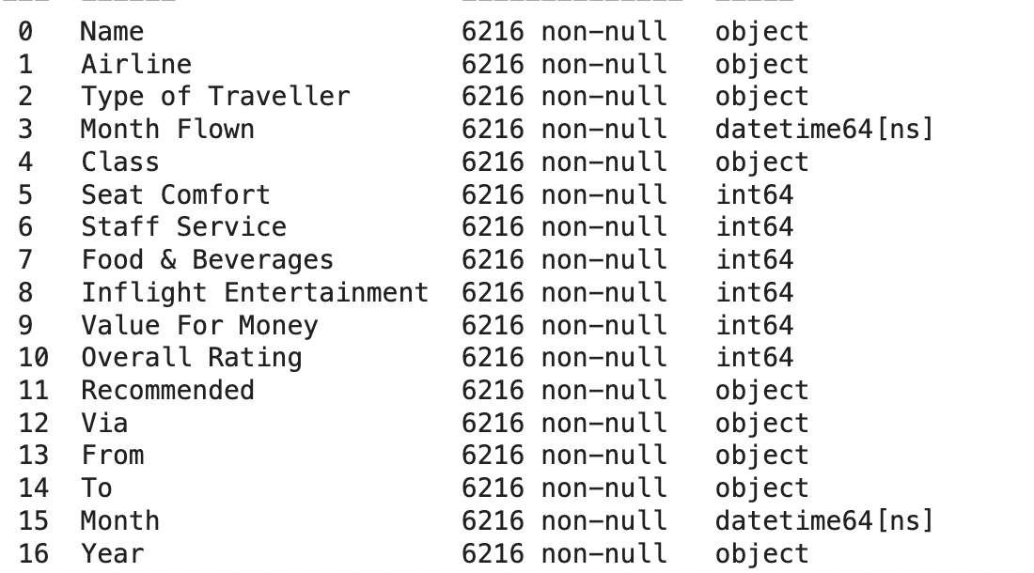
Data Description: The dataset used for this task consists of airline reviews from various airlines from 2013-2024, comprising 6,216 records after data cleaning (equivalent to 6,216 reviews). Each review includes 17 relevant attributes:
Airline: Airline name
Type of Traveler: Type of traveler
Month Flown: Month of flight
Class: Ticket class
Seat Comfort: Seat comfort rating
Food and Beverages: Food and beverage rating
Inflight Entertainment: Inflight entertainment rating
Value For Money: Value for money rating
Overall Rating: Overall rating
Recommended: Whether the customer recommends the airline or not
From: Departure point
Via: Transit point
To: Destination
Name: Customer name
Staff Service: Staff service rating
Month: Month of flight
Year: Year of flight

Slide 5
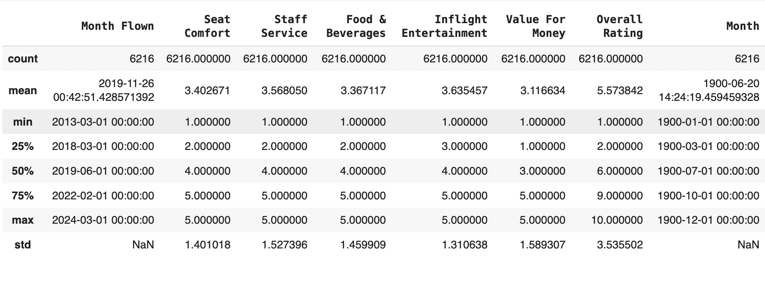
DATA PREPROCESSING
Data Description

Slide 6
01
EDA

Slide 7
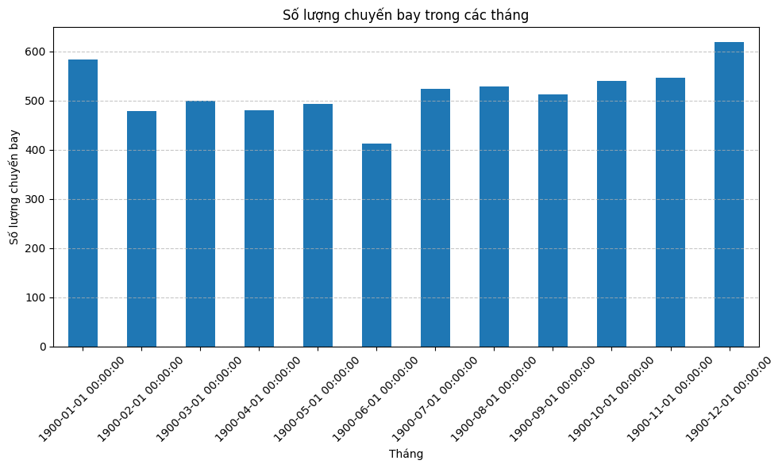
Notes:
The number of flights per month is fairly evenly distributed, but peaks in January and December.

Slide 8
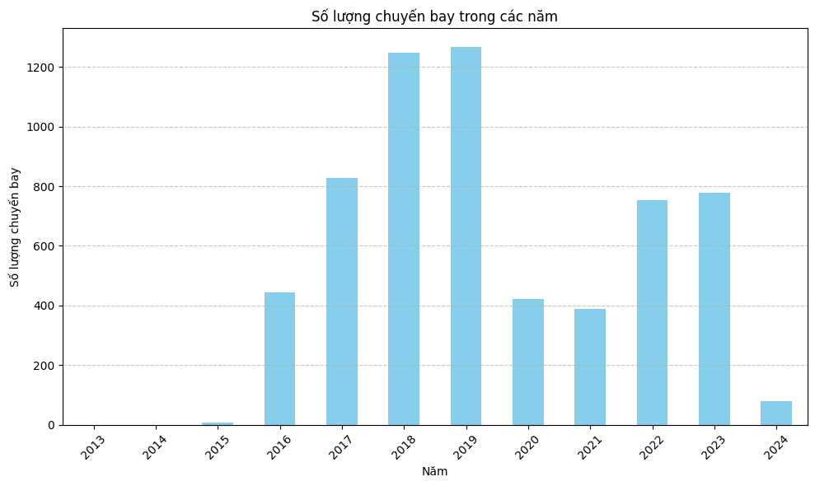
Notes:
The data from 2013 to 2015 is indeed very limited. Customer reviews began to be significantly utilized from 2016 onwards. In the years 2018 and 2019, the number of reviews reached its peak. However, due to the impact of the pandemic and other factors, the number of reviews in 2020 and 2021 decreased proportionally with the number of flights. After these two years, both the number of reviews and the number of flights are gradually recovering.

Slide 9
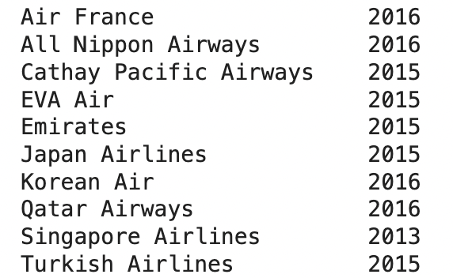
The airlines began collecting reviews
Notes:
Singapore Airlines is the only airline that began collecting reviews from 2013, which explains why there is very little data before 2015. Other airlines started collecting reviews from 2015 onwards, leading to a significant increase in the number of reviews received from that year.

Slide 10
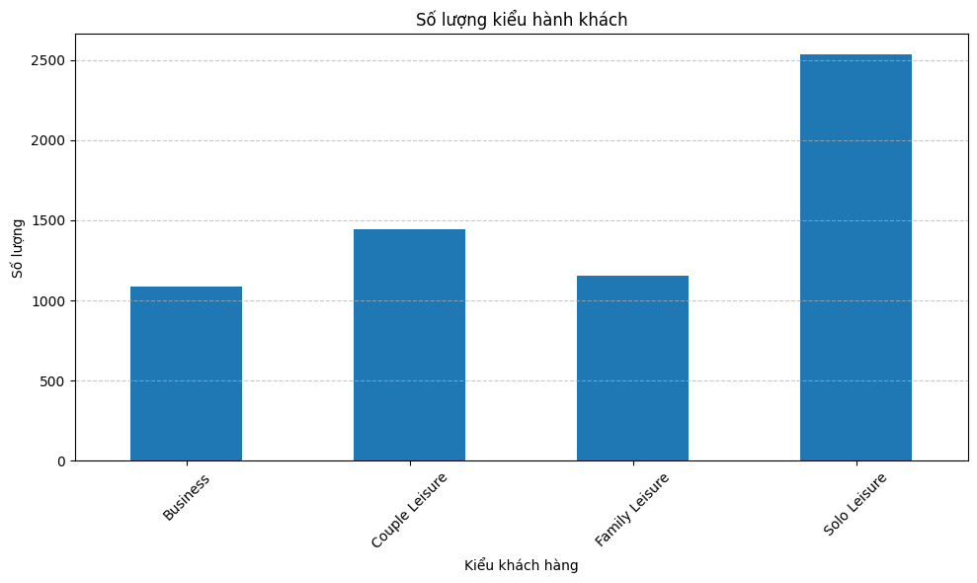

Slide 11
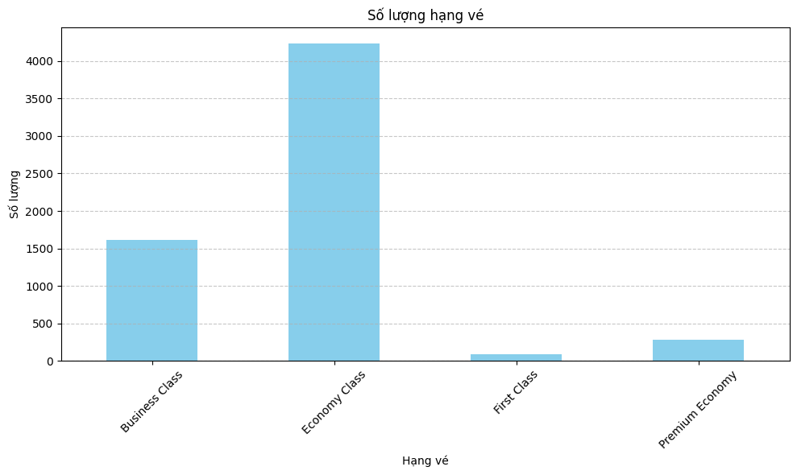
Notes:
The economy class ticket quantity is the highest as it caters to the largest demographic, which consists of individuals with average income levels, making it the most populous group in society.

Slide 12
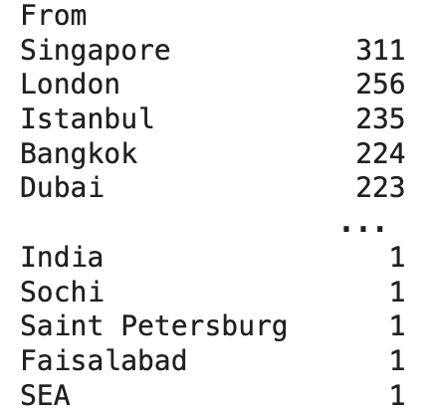
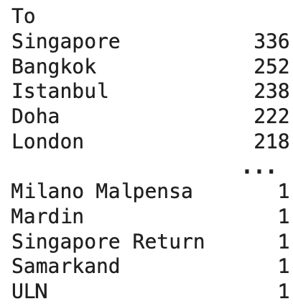
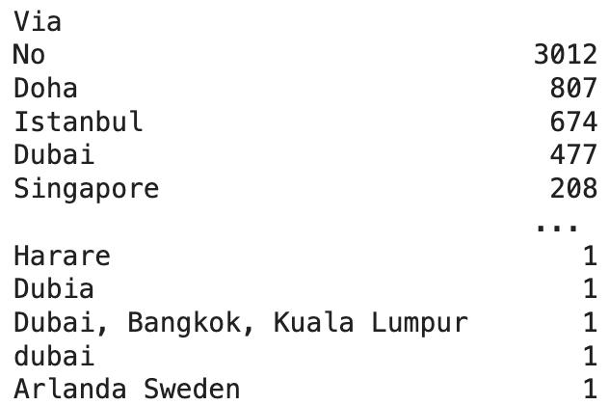
Airport
Notes:
Singapore Airlines has the largest number of reviews for both inbound and outbound flights, equivalent to the largest number of flights.

Slide 13
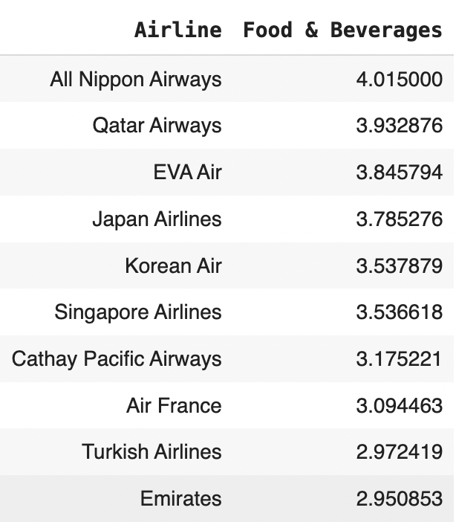
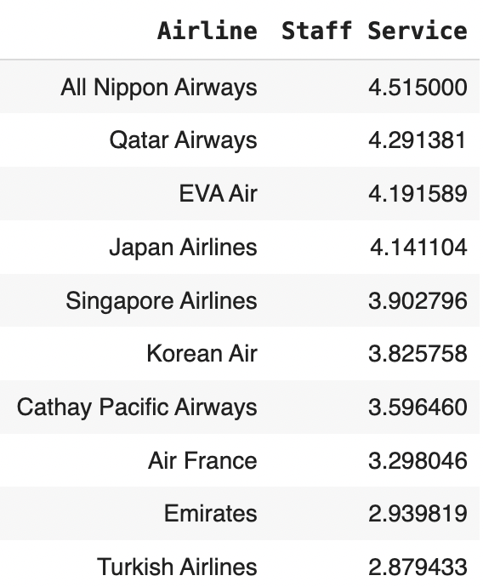
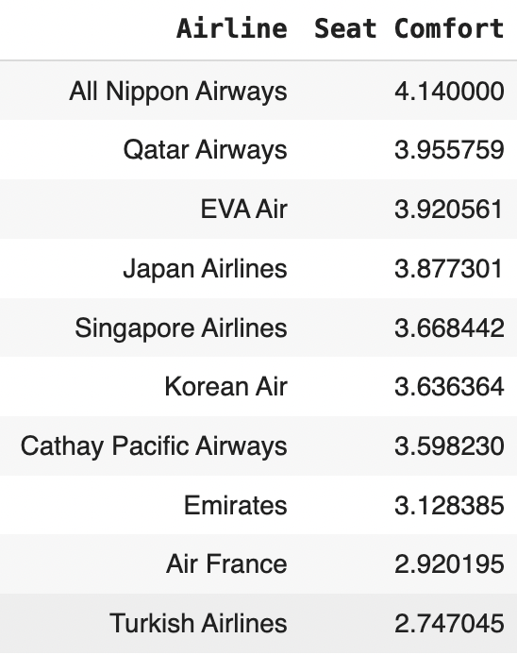
Notes:
In almost all evaluation criteria, All Nippon Airways consistently leads. Except for Inflight Entertainment Qatar Airways leads.
Food n Beverages:
High rated: Qatar Airways
Low rated: Emirates
Seat Comfort:
High rated: Qatar Airways
Low rated: Turkish Airlines
Staff service
High rated: Qatar Airways
Low rated: Turkish Airlines

Slide 14
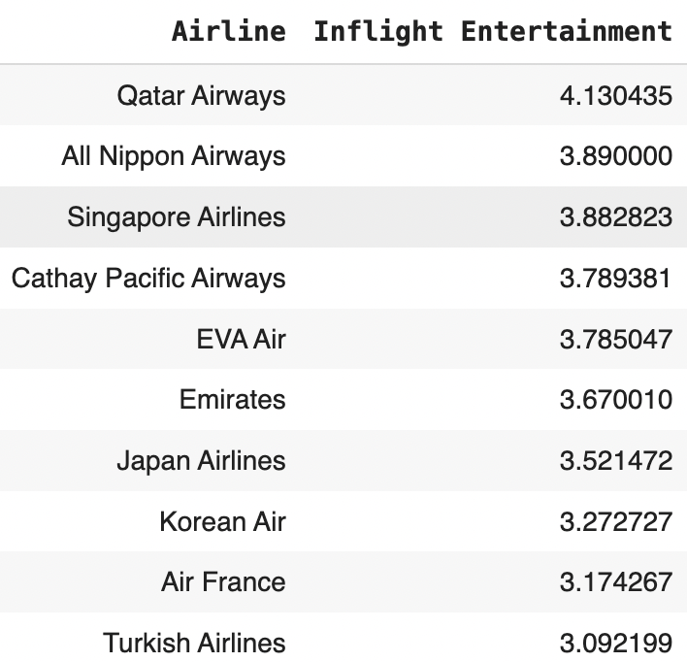
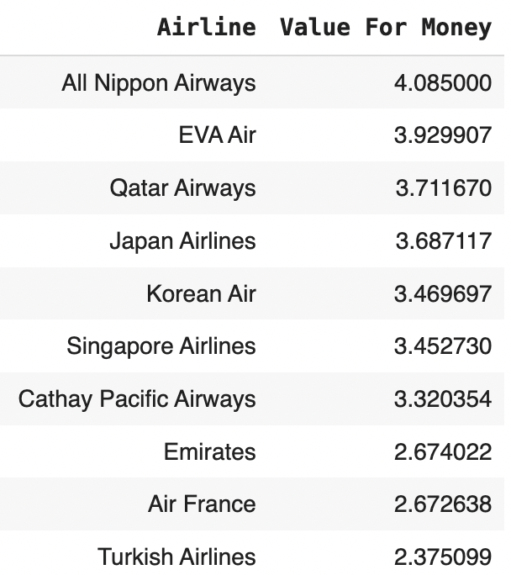
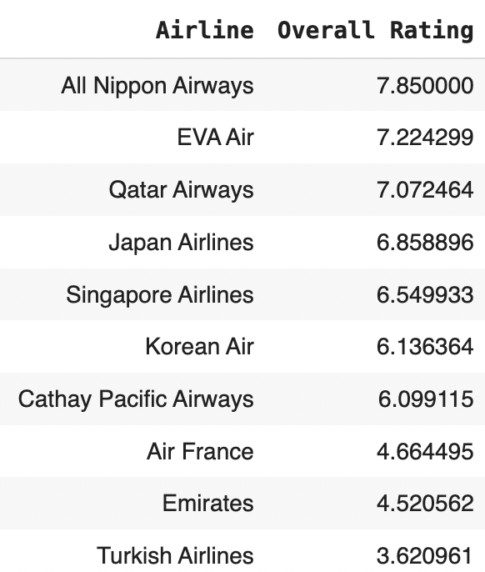
Notes:
Value for money:
High rated: EVA Air
Low rated: Turkish Airlines
Inflight Entertainment:
High rated: Qatar Airways
Low rated: Turkish Airlines

Slide 15
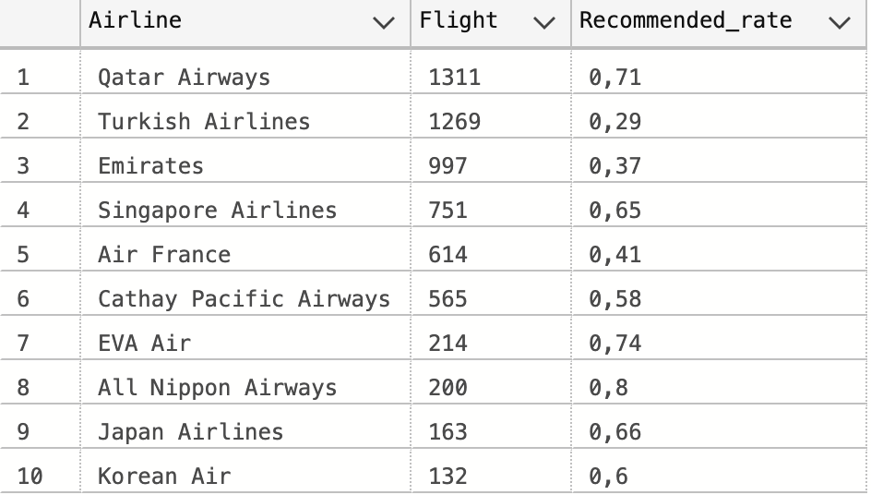
Notes:
HIGH AMOUNT: Qatar Airways, Turkish Airways (>1000)
LOW AMOUNT: EVA Air, All Nippon Airways, Japan Airlines, Korean Air(<300) The airlines with the highest Recommended ratings are Qatar Airways and All Nippon Airways.
Interestingly, the two most popular airlines have contrasting Recommended rates. While Qatar Airways has a relatively high rating, Turkish Airlines has the lowest Recommended rate.

Slide 16
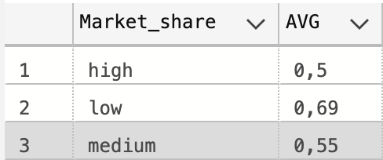
Notes:
Airlines with lower market shares tend to receive more recommendations from customers, and this rate decreases gradually as we move towards airlines with larger market shares. However, despite having a significant market share, Qatar Airways still maintains a very high recommendation rate.

Slide 17
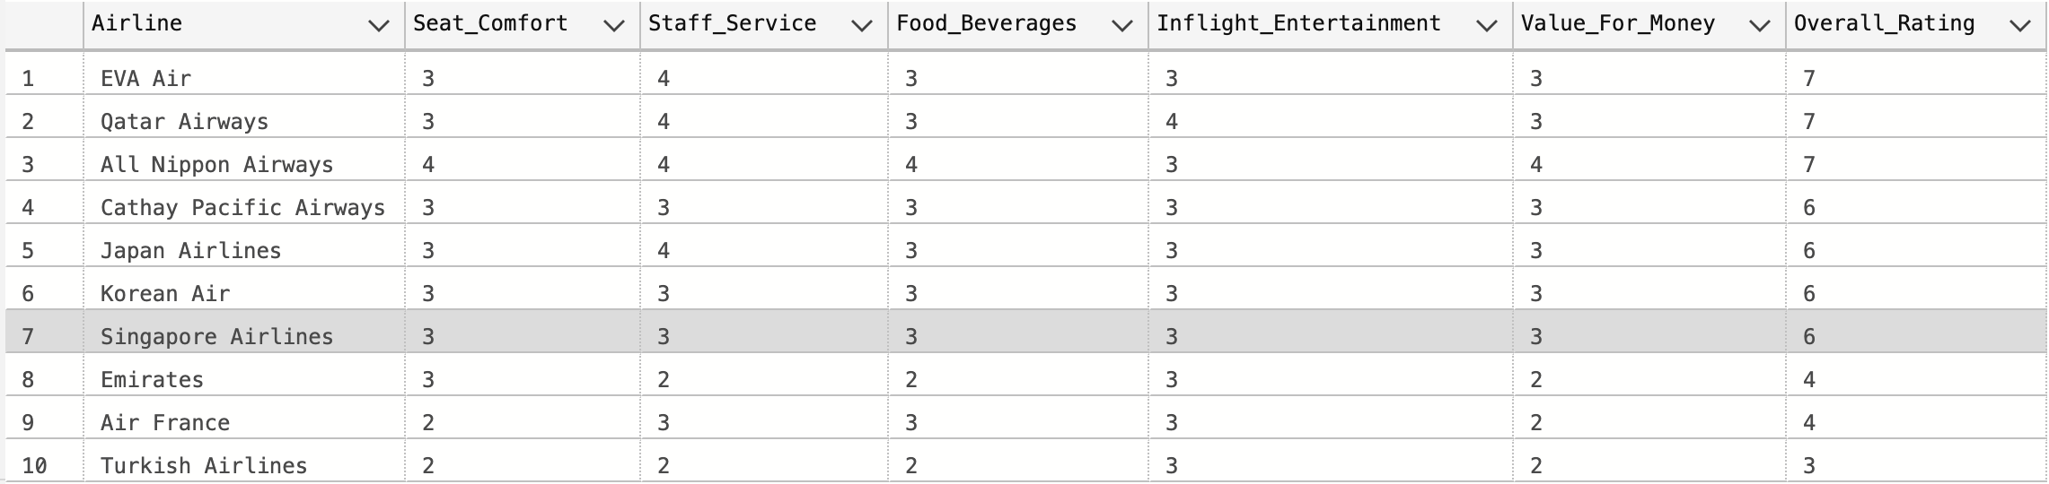

Slide 18
Class
Type of Traveler
Dominant at Economy Class: Turkish Airlines, Korean Air, Emirates, Air France
Dominant at Business Class: Qatar Airways
Dominant at First Class: Emirates, All Nippon Airways
Dominant at Premium Economy: EVA Air
Business Class: Business
Economy Class: Family Leisure
First Class: Solo Leisure
Premium Economy: Couple Leisure

Slide 19
2
SCALLING DATA

Slide 20
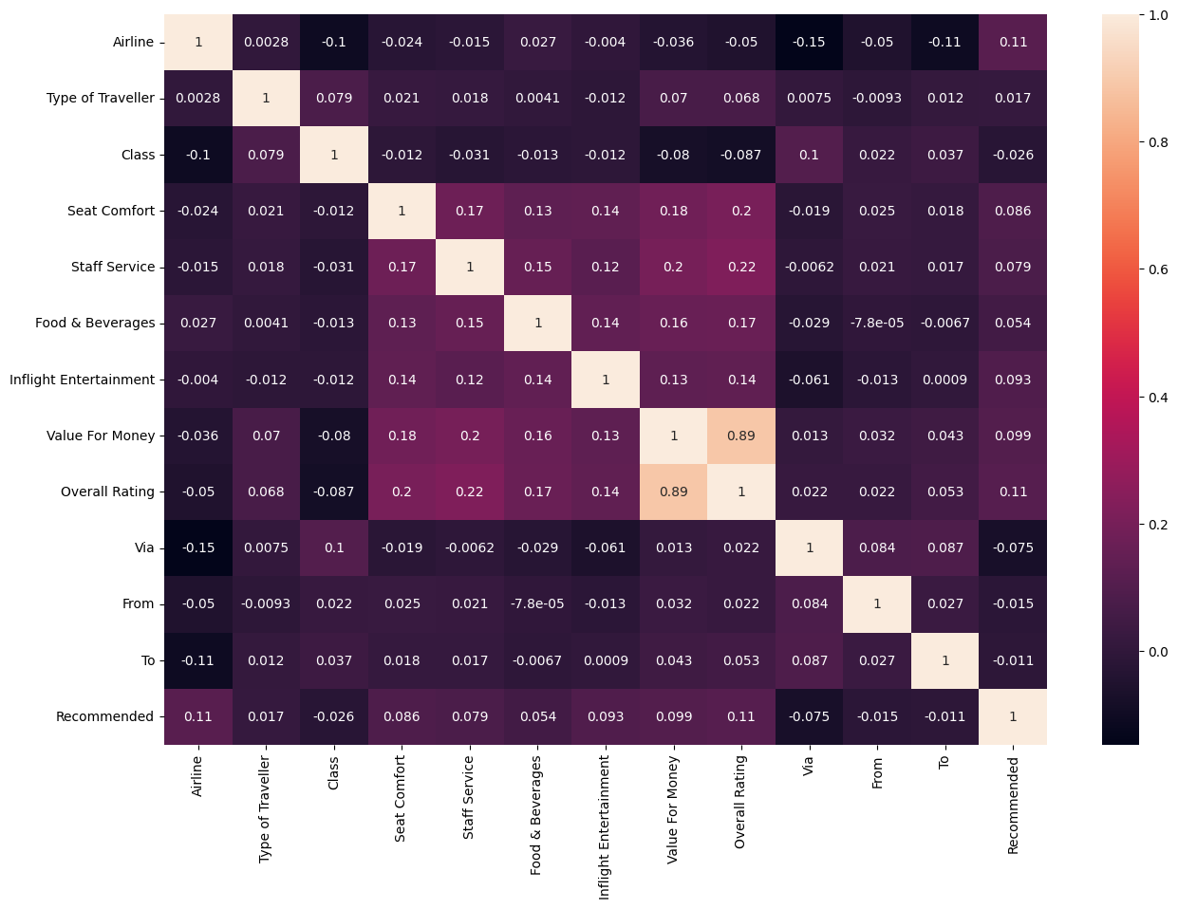
CORELLATION

Slide 21
The key factors influencing customers' decisions to recommend an airline include:
Airline
Seat Comfort
Staff Service
Inflight Entertainment
Value of money
Transit experience
Notes:
The key factors influencing customers' decisions to recommend an airline include:
Airline: The specific airline plays a significant role in customers' recommendations. Positive experiences with a particular airline, such as good customer service, on-time performance, and overall satisfaction, are likely to lead to recommendations.
Seat Comfort: The comfort of the seating arrangements onboard is crucial. Customers are more likely to recommend an airline if they find the seats comfortable, spacious, and conducive to a pleasant travel experience.
Staff Service : The quality of service provided by the airline staff, including flight attendants and ground personnel, greatly influences customers' perceptions. Friendly, helpful, and attentive staff are more likely to receive positive recommendations from customers.
Inflight Entertainment: The availability and quality of inflight entertainment options, such as movies, TV shows, music, and Wi-Fi connectivity, can enhance the overall travel experience. Airlines offering a wide range of entertainment options are more likely to be recommended by passengers.
Value of money: The cost of the flight tickets is a significant factor in customers' decisions. Competitive pricing and value for money are important considerations for customers when deciding whether to recommend an airline.
Transit Experience: Whether the flight involves a layover transit through another airport can impact customers' recommendations. Smooth transit experiences, efficient connections, and convenient facilities at transfer airports contribute to positive recommendations.

Slide 22
3
MODEL
Notes:
In this problem, the target variable is 'Recommended', indicating whether a customer is recommended (1) or not (0). Both false positives (a customer is predicted to be recommended, but it is not) and false negatives (a customer is predicted not to be recommended, but it is) could incur significant costs for the airline regarding investment categories. However, in this case, false positives may incur larger costs because the airline may miss out on potential customers by not accurately identifying the investment category that would have a large impact. Therefore, minimizing false positives, meaning maximizing recall for the 'recommended' class (1), would be a good approach. Precision is also important because with high precision, the false positives rate will decrease, meaning maximizing the cases where the model predicts a customer will be recommended, but they are not recommended. This could lead to misinvestment in categories that are not as important to customers.
Therefore, the F1-score, which is the harmonic mean of precision and recall, would be a good metric to use as it balances both precision and recall. Specifically, the F1-score for the 'Recommended' class (1) would be the most important metric for evaluating models in this project.
I will create a function to identify the best set of hyperparameters that maximize the F1-score for class 1 (recommended bookings). This method provides a reusable framework for hyperparameter tuning for other models as well

Slide 23
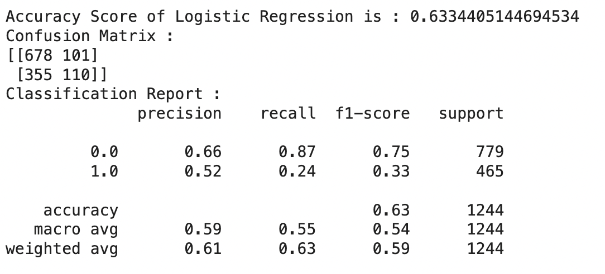
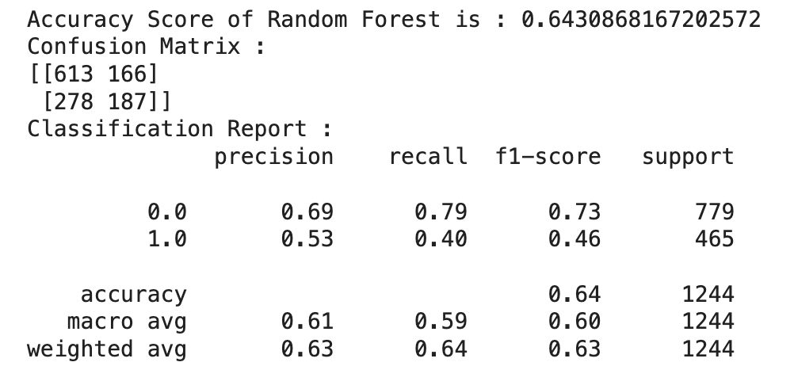
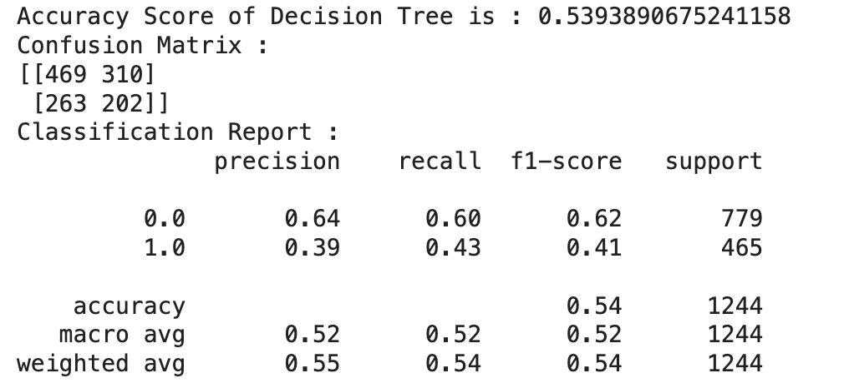
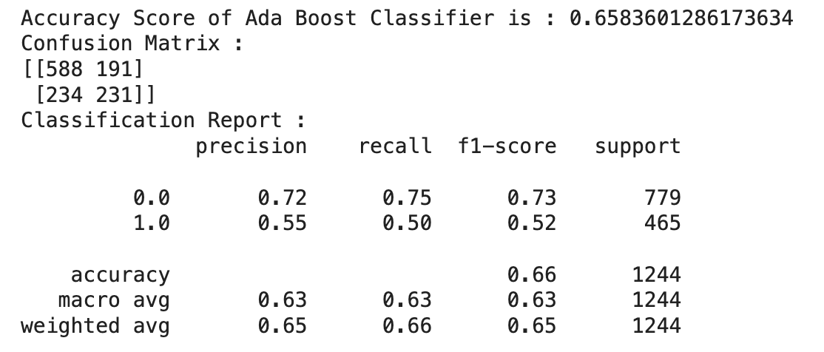
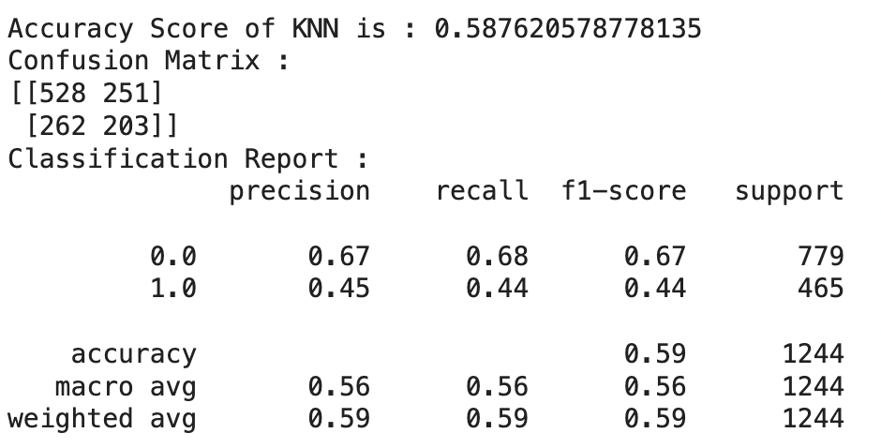

Slide 24
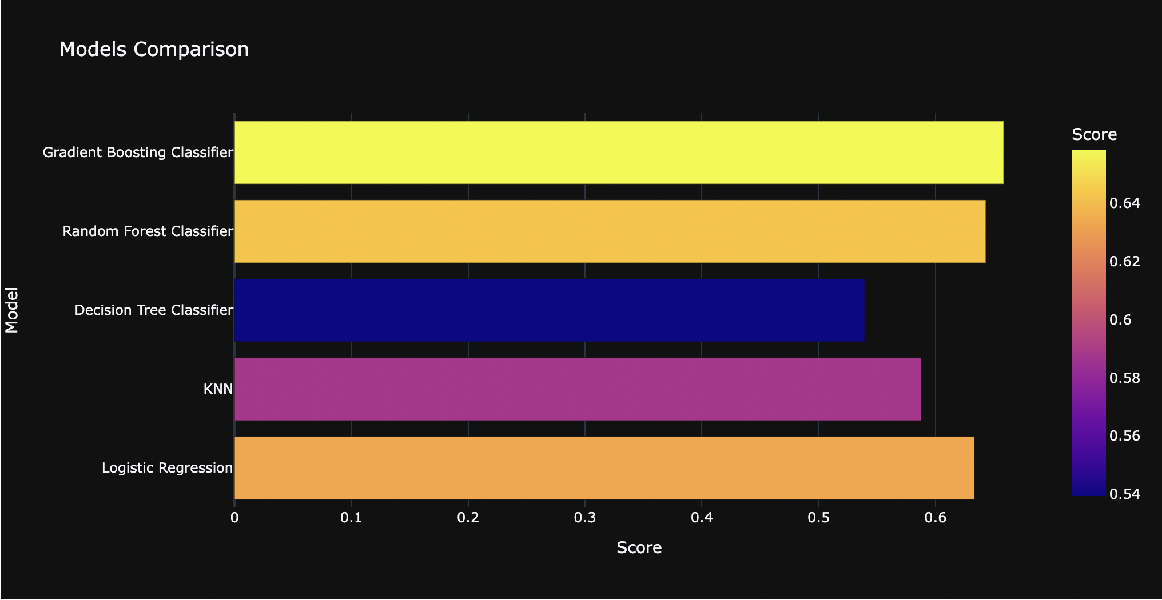
MODEL COMPARISON

Slide 25
4
CONCLUSION

Slide 26
Some general remarks about the data
The majority of passengers opt for economy class for their flights. However, airlines primarily focused on this segment often lack highly positive reviews. Conversely, airlines dominating the higher fare segments tend to receive very good reviews.
In almost all evaluation criteria, All Nippon Airways consistently leads, except for Inflight Entertainment where Qatar Airways leads.
Qatar Airways, Turkish Airlines, and Emirates are considered the largest airlines, yet only Qatar Airways receives positive evaluations, while Turkish Airlines and Emirates have very low ratings compared to smaller airlines.
The airlines with the highest Recommended ratings are Qatar Airways and All Nippon Airways. The Recommended ratings of airlines are inversely proportional to their scale.

Slide 27
Some directions for airlines
Enhancing the economy class experience is crucial due to its potential large customer base. However, focusing on high-yield passenger segments remains essential for maximizing efficiency.
Criteria for evaluating airline quality, such as ticket prices and staff service, should also be improved as much as possible.
Based on this data, pricing strategies can be adjusted during special occasions, leveraging ticket purchase frequency to maximize profits. Additionally, promotions should be offered in regions with low flight volumes to stimulate demand.

